Slide 1


Change Healthcare Ransomware Attack (2024)
Adrian Alexander
Najah Bell
Meghan Bennett​
Alexander Webb​

Slide 2
Intro to the Change Healthcare Ransomware Attack
WHEN DID THIS ATTACK OCCUR?
SUMMARY
WHAT WERE THE EFFECTS?
The Change Healthcare ransomware attack is the largest breach of medical data in U.S. history, compromising the sensitive information of approximately 190 million people.
This unprecedented breach exposed highly confidential personal and health data, posing serious risks to affected individuals if exploited by malicious actors.
The change Healthcare ransomware attack ransomware attack occurred on February 21, 2024.
The impact of this attack was devastating, causing widespread outages and crippling billing systems and insurance claims processing across the healthcare sector. This incident highlights how cyberattacks extend beyond data breaches, leading to severe operational disruptions that affect millions. It also provides critical insights into how organizations can respond to and recover from such attacks. Change Healthcare's efforts to notify affected individuals and restore security serve as a case study in crisis management and communication, offering valuable lessons for the industry.
WHAT WERE THE SECURITY IMPLICATIONS?
The breach has prompted investigations to assess compliance with security standards, including the HIPAA Security Rule.

Slide 3
Timeline
February 2024
Feb 17-20 – Change Healthcare (CHC) learns that cybercriminals accessed and copied data from their system.
Feb 21 – CHC experiences service outages and confirms a ransomware attack by BlackCat/ALPHV. Systems are encrypted, and CHC shuts down operations, hiring cybersecurity teams and involving law enforcement.
Feb 22 – UnitedHealth Group (UHG) identifies BlackCat/ALPHV as the attackers. The American Hospital Association (AHA) urges hospitals to disconnect from CHC to prevent further risks.
Feb 26 – BlackCat/ALPHV claims responsibility for the attack.
Feb 27-29 – The Department of Health and Human Services (HHS) warns hospitals about BlackCat; CHC confirms six terabytes of stolen data, including patient SSNs, medical records, and military data.
March 2024
Mar 1-3 – Security researchers detect a $22M bitcoin payment to BlackCat, suspected to be ransom paid by UHG.
Mar 4-6 – AHA and U.S. Senate criticize CHC’s financial aid response; five lawsuits filed against UHG.
Mar 8-13 – AHA warns recovery will take months; CHC receives safe-to-view files; federal HIPAA investigation begins.
Mar 15-18 – CHC resumes electronic payments, but 94% of hospitals face financial losses; UHG disburses $2B+ and restores 99% of pharmacy services.
Mar 22 – Senate bill introduced proposing cybersecurity requirements for Medicare payments.

Slide 4
Timeline, continued
May-July 2024
May 1 – UHG’s CEO testifies before U.S. Senate, confirming the attack resulted from stolen credentials and lack of multifactor authentication (MFA).
Jun 20 – CHC notifies business customers about data exposure.
Jun 2024 – 50+ lawsuits consolidated in Minnesota.
Jul 2024 – Breach response costs rise to $2.3B+, with $9B in advanced payments; CHC files breach report with HHS.
September-October 2024
Sep 3 – CHC notifies individual customers via mail.
Sep 19 – CHC requests multidistrict litigation consolidation.
Oct 17 – Attack cost rises to $2.457B, per UnitedHealth's Q3 report.
Oct 30 – CHC hires new CISO, Tim McKnight; former CISO becomes Chief Restoration Officer.

Slide 5
Identified Threat Actors
BlackCat (also known as ALPHV and Novberus) is a highly sophisticated and dangerous ransomware group that first appeared in 2001, known for stealing and encrypting sensitive data while demanding multimillion-dollar ransoms. Its aggressive tactics, advanced malware, and adaptability make it one of the most notorious cyber threats today. The group operated a public data leak site to pressure victims to pay ransom demands.
As of February 2024, the U.S. Department of State offered rewards of up to $10 million for information leading to the identification or location of ALPHV/BlackCat ransomware leaders. In March 2024, a BlackCat representative claimed the group was shutting down following the high-profile Change Healthcare ransomware attack. In early 2025, BlackCat had seemingly disappeared, with no confirmed activity from the group.

Slide 6
Motivations
Financial gains (Primary motive)
  Ransom payments: The BlackCat ransomware group demanded a ransom from Change Healthcare in exchange for restoring access to encrypted systems and preventing further exposure of stolen data. Reports indicate that UnitedHealth Group paid at least $22 million in Bitcoin as ransom, even though this did not fully mitigate the damages.
  Dark Web monetization: Stolen medical records are extremely valuable on the dark web, as they can be used for identity theft, insurance fraud, and financial scams. This type of data is more difficult to change compared to financial data (like credit card numbers), making it a long-term asset for cybercriminals.

Slide 7
Motivations
Geopolitical and/or Cyber warfare motives
  Targeting important infrastructure: The attack disrupted medical operations nationwide, affecting hospitals, pharmacies, and insurance providers.
  Potential foreign involvement: BlackCat has previously been linked to Russian-speaking cybercriminal networks. The attack could have served as a test of ransomware capabilities against U.S. healthcare infrastructure for future attacks.
Testing new malware & tactics
  Refining attacking methods: The CHC attack could have been an opportunity to test new encryption methods, data exfiltration techniques, and extortion strategies.
  Expanding Ransomware-as-a-Service (RaaS): BlackCat often operates as a Ransomware-as-a-Service (RaaS) group, meaning they develop hacking tools and lease them to affiliates. By successfully pulling off a high-profile attack it enhances their desirability and reputation in the cybercriminal ecosystem.

Slide 8
Capabilities
Deployment of sophisticated ransomware tools to encrypt critical systems.
Knowledge of healthcare infrastructure vulnerabilities.
Ability to identify and exploit unpatched systems or social engineering methods to gain access.

Slide 9
Impact on the Healthcare System
Patients
Healthcare Providers
190 Million Patient Records
  SSN's and Passport Numbers
  Patient Diagnosis and Medical Records
  Billing Information and Health Insurance Plans
Disruption/Delay of Service
Trust in Healthcare
Financial Impact
  Some providers reported losing up to $100 million daily
  Unable to Submit Claims/Receive Payment
Operational Impact
  Service Disruptions/Delays
  Patient Access to Care
  Risk of Business Closure

Slide 10
Impact on the Healthcare System
Insurance Providers
The cyberattack impacted numerous insurance providers including:
  Aetna
  AARP Medicare Advantage
  Metlife
  BlueCross Blue Shield
  Medicare/Medicaid services in several states
Experiences Delays in claims submissions and processing
Resulted in payments and provider reimbursement delays

Slide 11
Impact on the Healthcare System
Employees
Change Healthcare Employees
Healthcare Employees
Legal Implications
HIPPA Violations
Lawsuits
Additional Considerations
Potential Spike in Breaches
Future use of breached information

Slide 12
Financial Toll of the Attack
By September 30, 2024, UnitedHealth Group had reported $2.457 billion in total cyberattack impacts.
  Direct response costs amounted to $1.7 billion for the nine-month period ending September 30, 2024.
  Business disruptions cost $747 million in the same nine-month period.
  Additional Financial Measures
UnitedHealth Group provided over $9 billion in advance funding and interest-free loans to affected healthcare providers.
A $22 million ransom was paid to the ALPHV/BlackCat ransomware group in March 2024.

Slide 13
Financial Toll
Quarterly Breakdown
  Q1 2024: $872 million in losses reported
  By June 30, 2024 (end of Q2): $1.98 billion in costs paid, including $1.3 billion in direct costs
Other Financial Impacts
  Total impact per share of UnitedHealth Group: $2.60
  Earnings per share in Q3 2024 included $0.12 in business disruption impacts and excluded $0.28 in direct response costs

Slide 14
Financial Stability Post-Attack
Most of Change Healthcare's systems have been restored and are fully operational.
Transaction volumes are still not at pre-event levels
UHG is actively working with customers to bring transaction volumes back to pre-event levels and win new business.
For fiscal 2025, UHG projects net earnings of $28.15 to $28.65 per share and adjusted net earnings of $29.50 to $30.00 per share.
The company forecasts revenues between $450 billion and $455 billion for 2025.

Slide 15
Legal Ramifications
UnitedHealth Group faces significant legal challenges:
Multiple Lawsuits:
  39 healthcare providers and the National Community Pharmacists Association filed a class action lawsuit against UHG, Optum, and Change Healthcare
  At least five federal lawsuits have been filed against UHG
  Nebraska's Attorney General filed a lawsuit alleging violations of consumer protection and data security laws

Slide 16
Ongoing Lawsuits
Class Action Lawsuits:
  A class action complaint was filed in federal court against UHG on behalf of a Texas woman.
  The National Community Pharmacists Association and nearly 40 providers filed a class action lawsuit against UHG and its subsidiaries.
  At least five federal lawsuits have been filed against UHG.
Consolidated Litigation:
  Nearly 50 lawsuits related to the cyberattack have been consolidated in Minnesota, UHG's home state.
  A judge set a March 2025 deadline for Change Healthcare to file motions to dismiss certain claims in the consolidated lawsuits.

Slide 17
Ongoing Lawsuits
State Attorney General Lawsuit:
  Nebraska's Attorney General filed a lawsuit against Change Healthcare, Optum Inc., and UHG, alleging violations of consumer protection and data security laws.
Potential American Medical Association (AMA) Action:
  The AMA is considering legal actions against UHG, including the possibility of filing a class action lawsuit to recoup damages from the disruption caused by the breach. .

Slide 18
Stock Impact
Current stock price: $474.96
Year-to-date change: -74% (from $2,200.41 at the start of 2024)
  52-week range: $436.38 - $630.73
Market capitalization: $437.1 billion
Despite the initial drop, analysts predict some recovery:
  Forecast for end of 2025: $801, representing a 41% increase from current price
Short-term forecast for March 2025: $593, with a range of $546 to $640

Slide 19
Stock Impact continued
Potential Damages:
The class action could exceed $5 million in damages
Plaintiffs seek compensation for financial losses and an injunction to prevent similar incidents
Regulatory Investigation:
The Office for Civil Rights (OCR) launched an investigation to determine if the breach resulted from HIPAA Security Rule violations
Notification Requirements:
Senators have urged UHG to issue breach notifications by June 21, 2024
Failure to comply with HIPAA Breach Notification Rule could lead to additional penalties

Slide 20
Response and
Mitigation Efforts
Immediate Actions:
  Change Healthcare swiftly disconnected compromised systems and took additional systems offline to contain the ransomware spread.
  The company implemented manual processes and operational workarounds to sustain business functions while restoring digital systems.
Instigation and Recovery:
  UnitedHealth Group, Change Healthcare’s parent company, engaged top cybersecurity firms to investigate the breach and collaborated with U.S. government agencies.
  The company paid approximately $22 million in Bitcoin as ransom.
Federal Support:
  The Cybersecurity and Infrastructure Security Agency (CISA) and the Federal Bureau of Investigation (FBI) provided key indicators of compromise and mitigation strategies.
  The Department of Health and Human Services (HHS) issued guidance and resources to help healthcare organizations enhance security and maintain HIPAA compliance.

Slide 21
Response and
Mitigation Efforts
Long-term Measures:
  Emphasis on conducting thorough risk assessments and implementing robust security practices to safeguard electronic protected health information.
  Continuous updates and training on cybersecurity best practices for healthcare providers and their partners.
  Implement advanced threat detection systems to identify and block ransomware attacks before they cause harm.
  Maintain offline backups/snapshots of critical data and regularly test recovery processes.
  Patch systems promptly and conduct regular vulnerability assessments.
  Train staff on recognizing phishing attempts and suspicious activities through other common attack vectors.

Slide 22

Additional Response & Mitigation Efforts
Regulatory Oversight:
  Increased HIPAA Audits – ORC and HHS intensified audits of Change Healthcare.
  Stricter Vendor Management Requirements – Change Healthcare began conducting thorough risk assessments of third-party vendors and ensuring they adhered to the robust cybersecurity standards.
  Enhanced Reporting Obligations – Change Healthcare was mandated to provide more detailed and frequent reports on their cybersecurity measures
  Implementation of Best Practices - Created a detailed company-wide plan in the event of any future cybersecurity breaches.
  Legislative Oversight - Congress held hearings to investigate the breach and its impact in efforts to strengthen cybersecurity requirements for healthcare organizations

Slide 23
Additional Response & Mitigation Efforts, continued...
Cybersecurity investments post-breach:
  Enhanced Security Measures – Established multi-factor authentication, threat detection system, network segmentation.
  Employee Training – Trained employees to be more aware of phishing, and social engineer attempts.
  Third-Party Risk Management – Made sure vendors comply with cybersecurity standards
  Incident Response Planning - Created a detailed plan in the event of an future cybersecurity breach.

Slide 24
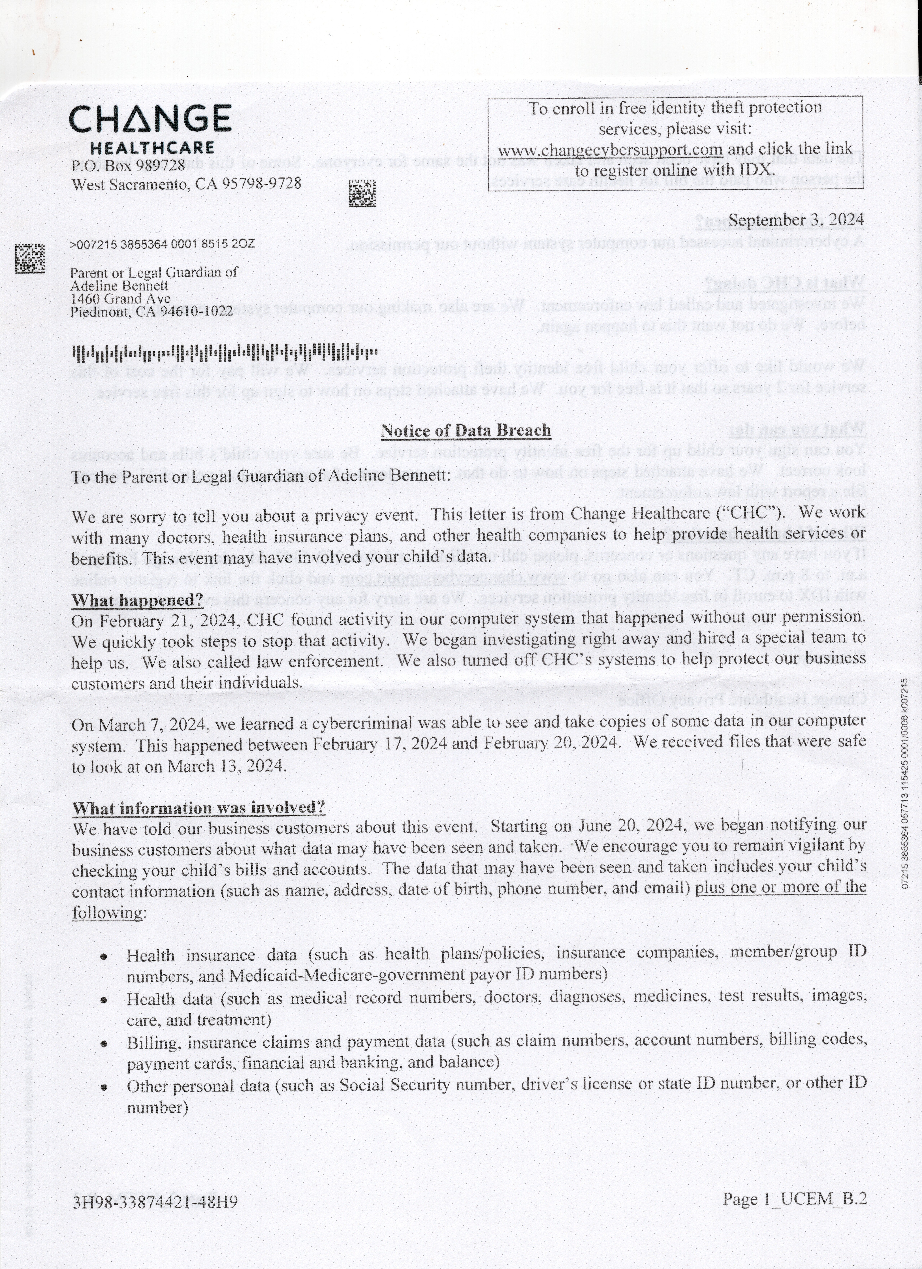
Privacy Concerns
Protected Health Information (PHI) & Personally Identifiable Information (PII) exposed
  The breach compromised highly sensitive medical records, including diagnoses, prescriptions, treatments, and insurance details.
  Personally Identifiable Information (PII) such as full names, Social Security numbers, addresses, and birthdates were also at risk.
  The exposure of this data increases the likelihood of identity theft, financial fraud, and medical fraud (e.g., criminals using stolen medical identities to obtain services or prescriptions).
Medical Identity Theft & Fraud
  Stolen healthcare records can be sold on the dark web, leading to fraudulent medical claims, prescription abuse, and unauthorized insurance claims.
  Unlike credit card data, medical records cannot be easily changed, making them long-term targets for fraud and abuse.

Slide 25




Prevention
Implement Multi-Factor Authentication (MFA): Mandatory MFA for all user access, especially for Citrix and VPN logins, verifying credentials alone are not enough to gain access to the system.
Zero Trust Security: access is restricted based on need-to-know and least privilege principles.
Endpoint Detection and Response (EDR): access is restricted based on need-to-know and least privilege principles.
Restrict Public Exposure of Citrix Portal: Putting Citrix portal behind a VPN, limits access to approved IP ranges and geo-blocking to prevent logins from unapproved regions.
Continuous Log Monitoring: detect, record, and analyze security events in real time to identify suspicious activities and unauthorized access.
Privileged Access Management (PAM): Restricted access for users and administrators use dedicated accounts while session monitoring for high-privilege Citrix sessions.
Access points:
Citrix portal with no Multi-Factor Authentication led to UnitedHealth cyber attack
The attackers remotely accessed desktops nine days later.

Slide 26

Lessons Learned From The Change Healthcare Incident
  Importance of third-party risk Management
  Importance of Employee Training to mitigate risk of phishing attempts.
  Importance of MFA
  Incident Response Planning is critical
  Importance of Regulatory Standards for organizations

Slide 27
Conclusion:
A Wake-Up Call for Healthcare Cybersecurity
This attack was one of the largest healthcare data breaches in history with an estimated 100 million individuals affected, the breach exposed 54% of all healthcare records compromised in 2024. The attack paralyzed healthcare operations nationwide, preventing patients from accessing medications and disrupting healthcare providers’ revenue cycles.
The breach highlights concerns about cybersecurity failures and industry-wide vulnerabilities. Implementing multifactor authentication (MFA) could have prevented the attack and ransom payments. This incident highlighted how corporate consolidation without proper cyber security checks in healthcare can create dangerous single points of failure, leaving millions of patients and providers vulnerable when a centralized system is compromised.
As customers, lawmakers and regulators demand accountability, this attack serves as a wake-up call for the healthcare industry. The failure of one of the largest healthcare entities, UnitedHealth Group, to implement basic cybersecurity measures underscores the urgent need for stronger security requirements, regulatory oversight, and better preparedness for future ransomware attacks. Without immediate reforms, the risks to patient safety, financial stability, and national healthcare infrastructure will only continue to grow.

Slide 28

Resources
Letter addressed to Meghan Bennett from Change Healthcare, informing her that her daughter's personal information had been compromised in the data breach.
https://www.dataminr.com/resources/insight/change-healthcare-ransomware-attack-shines-light-on-third-party-risk-and-exposure/
https://personcenteredtech.com/2025/02/26/one-year-after-the-change-healthcare-breach-what-group-practices-must-learn/
https://www.hipaajournal.com/change-healthcare-responding-to-cyberattack/
https://ascentient.com/insights/the-change-healthcare-ransomware-attack-how-to-protect-your-practice/

